Slide 1

University of Central Florida COP 3330 Object Oriented Programming

Slide 2
Agenda
Administrative
Control flow

Slide 3
Control Flow

Slide 4
Control Flow
Statements in source code files are generally executed sequentially from top to bottom, in the order that they are written
Control flow statements break up the flow of execution with
decision making
looping
Allows for programs to execute blocks of code conditionally

Slide 5
Control Flow
decision-making statements
if-else
if-else if-else
switch
looping statements
for
while
do-while
branching statements
break
continue
return

Slide 6
Decision-Making Statements

Slide 7
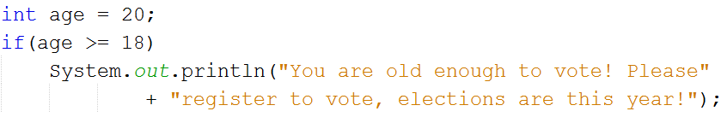
Control Flow
if
most basic of all the control flow statements
Instructs program to execute a certain section of code only if a particular test evaluates to true
If the evaluation results in false control jumps to the end of the if statement

Slide 8
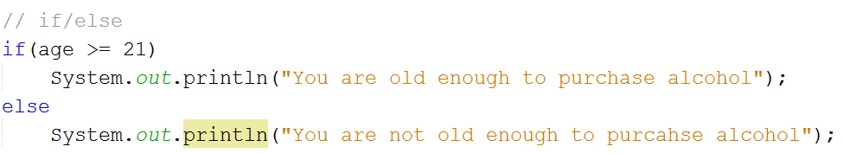
Control Flow
if-else
provides a secondary path of execution when an "if" clause evaluates to false

Slide 9
Control Flow
if-else if-else
Use when more than one condition needs to be evaluated
The value can satisfy more than one expression in the compound statement
Once a condition is satisfied, the appropriate statements are executed and the remaining conditions are not evaluated
The else leg is NOT required

Slide 10
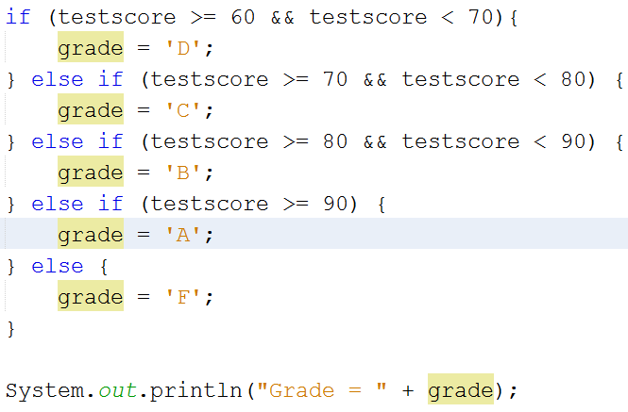
Control Flow
if-else if-else

Slide 11
Control Flow
switch
switch statement can have a number of possible execution paths
works
Primitive data types
byte
short
char
int
enumerated types
String class
special classes that wrap primitive types
Character
Byte
Short
Integer

Slide 12
Control Flow
switch
body of a switch statement is the switch block
a statement in the switch block can be labeled with one or more case or default labels
switch statement evaluates its expression then executes all statements that follow the matching case label

Slide 13
Control Flow
switch
the break statement
terminates the enclosing switch statement.
Control flow continues with the first statement following the switchblock.
The break statements are necessary, without them, statements in switch blocks fall through:
All statements after the matching case label are executed in sequence, regardless of the expression of subsequent case labels, until a break statement is encountered.

Slide 14
Control Flow
switch
the break statement
Technically, the final break is not required because flow falls out of the switch statement
Using a break is recommended so modifying the code is easier and less error prone.
The default section handles all values that are not explicitly handled by one of the case sections.
In Java SE 7 and later can use String object in the switch statement's expression

Slide 15
Control Flow
switch
String in the switch expression is compared with the expressions associated with each case label
Similar to String.equals method were being used
In order for the method to accept any month regardless of case month is converted to lowercase using the toLowerCase method
all the strings associated with the caselabels are in lowercase.

Slide 16
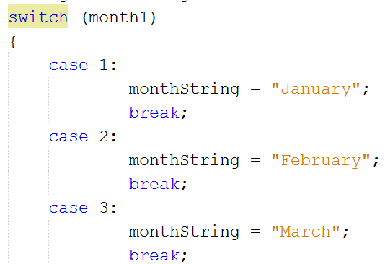
Control Flow
switch

Slide 17
Control Flow
If-else if-else or switch?
use if-then-else statements or a switch statement based on readability and the expression statement being tested
An if-then-else statement can test expressions based on ranges of values or conditions
a switch statement tests expressions based only on a single integer, enumerated value, or String object

